Slide 1

PYTHON
OBJECT ORIENTED PROGRAMMING

Slide 2

OBJECTIVES
About OOPs.
Classes.
Object or Instances.

Slide 3
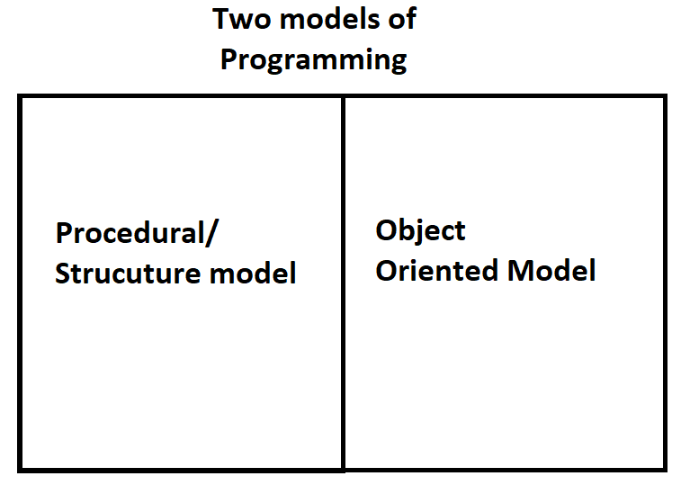

Slide 4
OOPs
The main concept of OOPs is to bind the data and the functions that work on that together as a single unit so that no other part of the code can access this data.

Slide 5
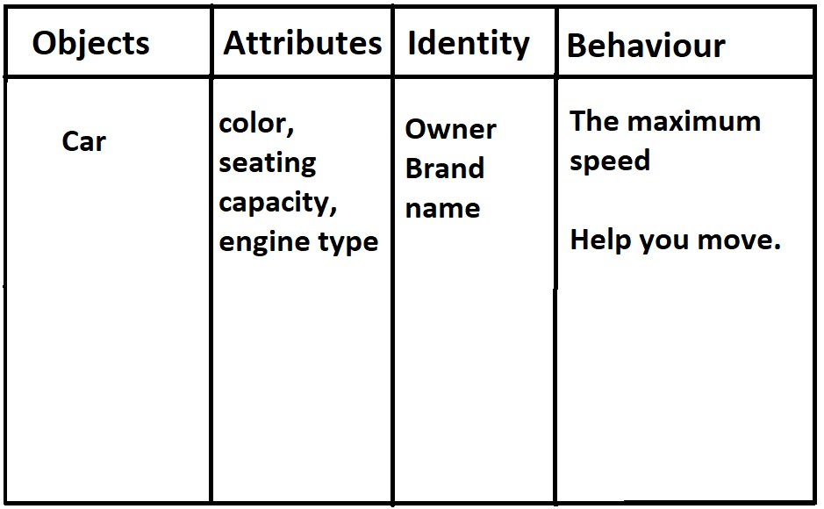
OBJECTS :

Slide 6
OBJECT :
Object is an entity that has state and behavior associated with it
An object basically consist of
State/Attribute: It is represented by the attributes of an object. It also reflects the properties of an object.
Behavior: It is represented by the methods of an object. It also reflects the response of an object to other objects.
Identity: It gives a unique name to an object and enables one object to interact with other objects.

Slide 7
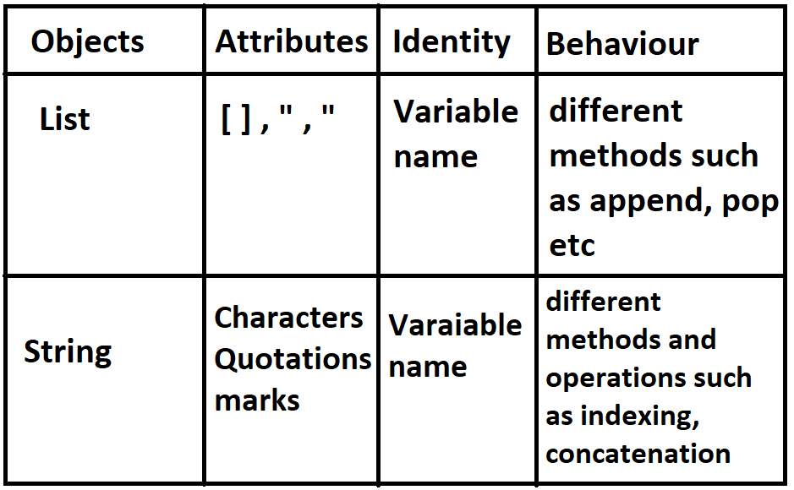
OBJECTS :

Slide 8
MAIN CONCEPTS OF OOPS
Class.
Objects.
Polymorphism.
Encapsulation.
Inheritance.

